Slide 1

AI Classification
PRESENTED TO
Dr. Mohamed Abo Rezaa
Presented by
Salma EL Sayed-17105510

Slide 2
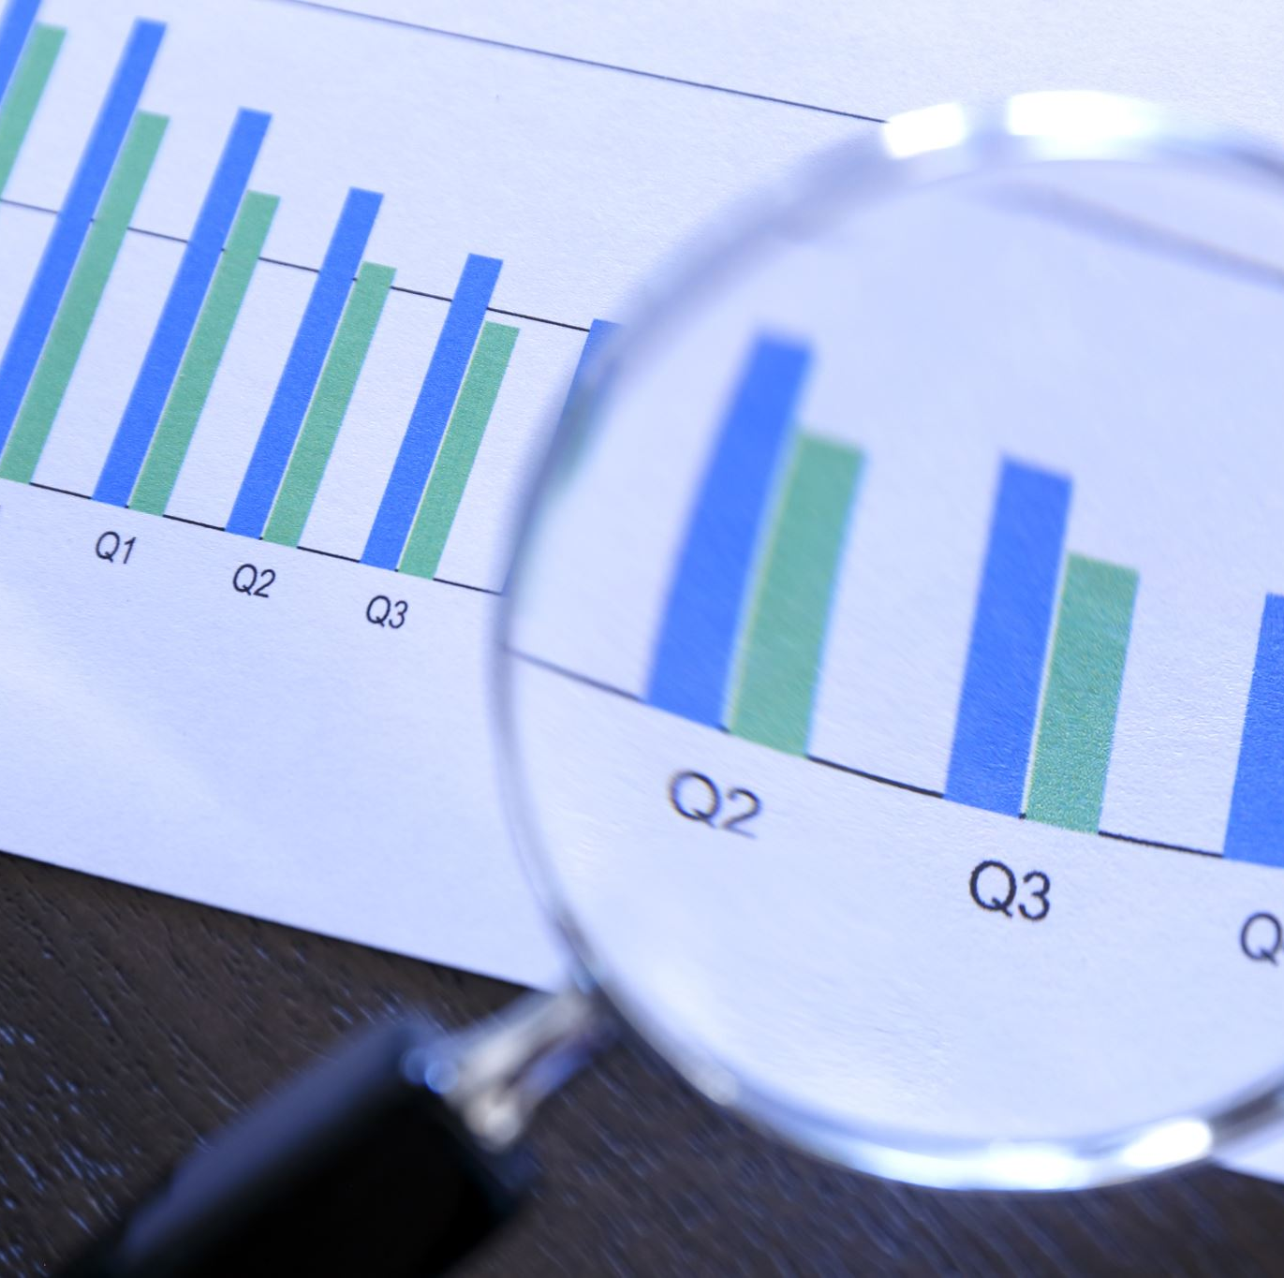
What is classification?
It is the process of categorizing given set of data into classes
It can be performed on structured or unstructured data
Process starts with predicting the class of given data points
Classes are referred to as target, label of categories, in general compare the characteristic to the data you are trying to classify

Slide 3
Introduction
Iris virginica, with the common name Virginia iris, is a perennial species of flowering plant, native to eastern North America.
It is common along the coastal plain from Florida to Georgia in the South-eastern United States.

Slide 4
Project objective
In this Iris dataset, there are three kind of species i.e., Setosa, Versicolor and **Virginica **and 50 samples on each species having their respective Sepal Length, Sepal Width, Petal Length and Petal Width. Which we aim to make an ai to predict 30% of the data.

Slide 5
The problem definition
Using the classification model to predict the type of the iris flower which will help to make a mobile app to use an air drown to automatic recognize it.

Slide 6
DATA ATTRIBUTES
Sepal Length in cm
Sepal width in cm
Petal length in cm
Class : Iris Setosa, Iris versicolor, Iris Virginica

Slide 7
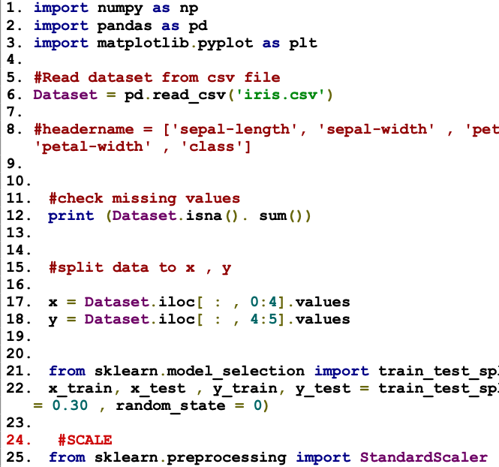
Code

Slide 8
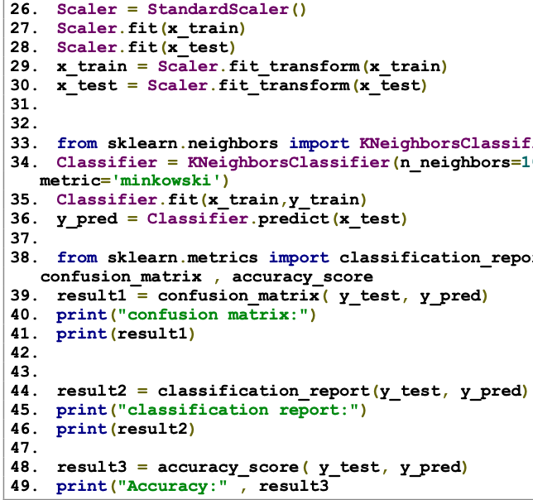
Code

